Slide 1

Dive into Deep Learning
Chapter 2:
Preliminaries Data Manipulation and Preprocessing

Slide 2
Contents
Data Manipulation
Reading the Dataset
Handling Missing Data
Linear Algebra
Scalars
Automatic Differentiation
Probability
Calculus
Documentation
Data Preprocessing
Conversion to the Tensor Format
Matrices
Tensors
Getting Started
Operations
Broadcasting Mechanism
Indexing and Slicing
Saving Memory
Conversion to Other Python Objects
Vectors
Basic Properties of Tensor Arithmetic
Derivatives and Differentiation
Partial Derivatives
Gradients
Chain Rule
A Simple Example
Backward for Non-Scalar Variables
Detaching Computation
Computing the Gradient of Python Control Flow
Basic Probability Theory
Dealing with Multiple Random Variables
Expectation and Variance
Finding All the Functions and Classes in a Module
Finding the Usage of Specific Functions and Classes
+6 sections
Linear Algebra cont.
Reduction
Dot Products
Matrix-Vector Products
Matrix-Matrix Multiplication
Norms
More on Linear Algebra

Slide 3
Contents
CH2
Data Manipulation
Data Preprocessing
Linear Algebra
Linear Algebra cont.
Calculus
Automatic Differentiation
Probability
Documentation
Getting Started
Reading the Dataset
Scalars
Reduction
Derivatives and Differentiation
A Simple Example
Basic Probability Theory
Finding All the Functions and Classes in a Module
Operations
Handling Missing Data
Vectors
Dot Products
Partial Derivatives
Backward for Non-Scalar Variables
Dealing with Multiple Random Variables
Finding the Usage of Specific Functions and Classes
Broadcasting Mechanism
Conversion to the Tensor Format
Matrices
Matrix-Vector Products
Gradients
Detaching Computation
Expectation and Variance
Indexing and Slicing
Tensors
Matrix-Matrix Multiplication
Chain Rule
Computing the Gradient of Python Control Flow
Saving Memory
Basic Properties of Tensor Arithmetic
Norms
Conversion to Other Python Objects
+6 sections
More on Linear Algebra

Slide 4
Preliminaries
All machine learning is concerned with extracting information from data.
Machine learning typically requires working with large datasets, which we can think of as tables
The rows correspond to examples, and
The columns correspond to attributes.
Sepal length | Sepal width | Petal length | Petal width | Species
5.1 | 3.5 | 1.4 | 0.2 | setosa
4.9 | 3.0 | 1.4 | 0.2 | setosa
7.0 | 3.2 | 4.7 | 1.4 | versicolor
6.4 | 3.2 | 4.5 | 1.5 | versicolor
7.2 | 3.6 | 6.1 | 2.5 | virginica
6.5 | 3.2 | 5.1 | 2.0 | virginica
Features or covariates
Labels
Instance or example
Example of Iris dataset
Linear algebra gives us a powerful set of techniques for working with tabular data.

Slide 5
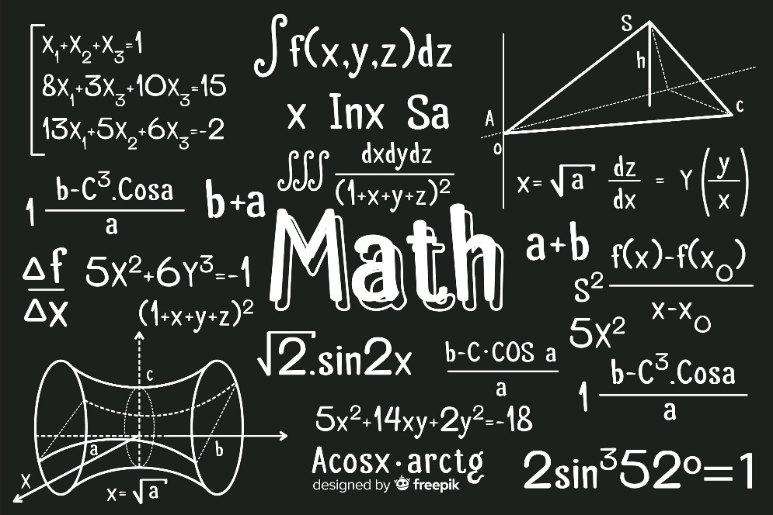
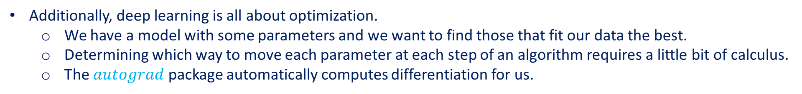
Preliminaries
Additionally, deep learning is all about optimization.
We have a model with some parameters and we want to find those that fit our data the best.
Determining which way to move each parameter at each step of an algorithm requires a little bit of calculus.
The $autograd$ package automatically computes differentiation for us.
Calculus- the mathematics of change
Next, machine learning is concerned with making predictions:
What is the likely value of some unknown attribute, given the information that we observe?
To reason rigorously under uncertainty we will need to invoke the language of probability.

Slide 6
Preliminaries
This chapter provides a rapid introduction to basic and frequently-used mathematics to allow anyone to understand at least most of the mathematical content of the book.

Slide 7
Contents
CH2
Data Manipulation
Data Preprocessing
Linear Algebra
Linear Algebra cont.
Calculus
Automatic Differentiation
Probability
Documentation
Getting Started
Reading the Dataset
Scalars
Reduction
Derivatives and Differentiation
A Simple Example
Basic Probability Theory
Finding All the Functions and Classes in a Module
Operations
Handling Missing Data
Vectors
Dot Products
Partial Derivatives
Backward for Non-Scalar Variables
Dealing with Multiple Random Variables
Finding the Usage of Specific Functions and Classes
Broadcasting Mechanism
Conversion to the Tensor Format
Matrices
Matrix-Vector Products
Gradients
Detaching Computation
Expectation and Variance
Indexing and Slicing
Tensors
Matrix-Matrix Multiplication
Chain Rule
Computing the Gradient of Python Control Flow
Saving Memory
Basic Properties of Tensor Arithmetic
Norms
Conversion to Other Python Objects
+6 sections
More on Linear Algebra

Slide 8
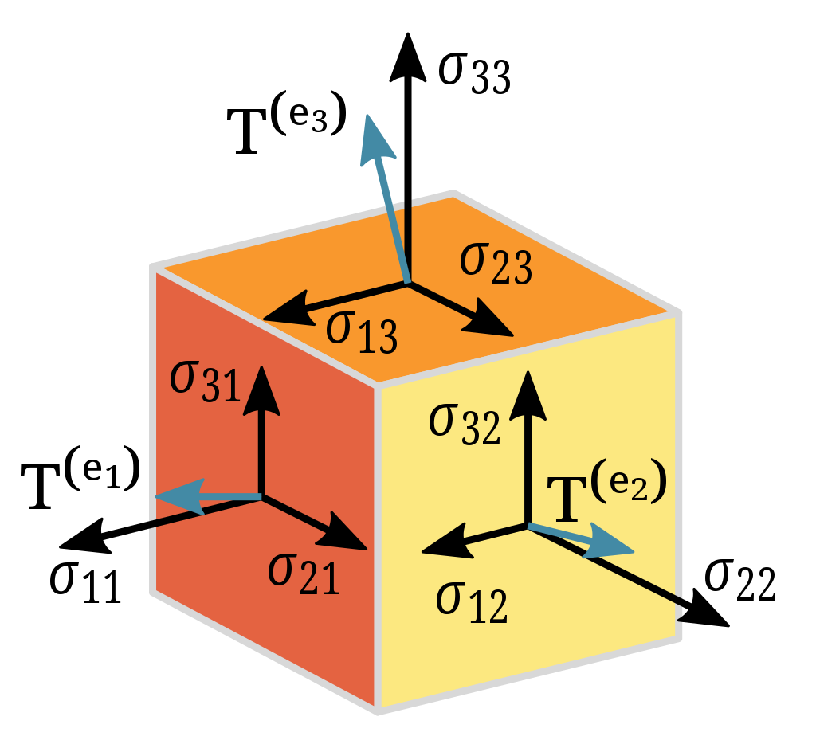
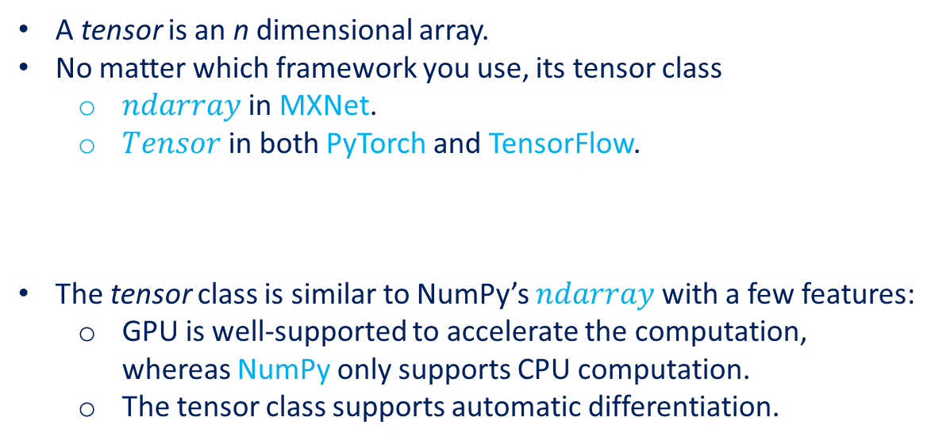
Data Manipulation
There are two important things we need to do with data:
Acquire them
Process them once they are inside the computer.
A tensor is an n dimensional array.
No matter which framework you use, its tensor class
$ndarray$ in MXNet.
$Tensor$ in both PyTorch and TensorFlow.
The tensor class is similar to NumPy’s $ndarray$ with a few features:
GPU is well-supported to accelerate the computation, whereas NumPy only supports CPU computation.
The tensor class supports automatic differentiation.
The second-order Cauchy stress tensor (T) describes the stress forces experienced by a material at a given point.

Slide 9
Contents
CH2
Data Manipulation
Data Preprocessing
Linear Algebra
Linear Algebra cont.
Calculus
Automatic Differentiation
Probability
Documentation
Getting Started
Reading the Dataset
Scalars
Reduction
Derivatives and Differentiation
A Simple Example
Basic Probability Theory
Finding All the Functions and Classes in a Module
Operations
Handling Missing Data
Vectors
Dot Products
Partial Derivatives
Backward for Non-Scalar Variables
Dealing with Multiple Random Variables
Finding the Usage of Specific Functions and Classes
Broadcasting Mechanism
Conversion to the Tensor Format
Matrices
Matrix-Vector Products
Gradients
Detaching Computation
Expectation and Variance
Indexing and Slicing
Tensors
Matrix-Matrix Multiplication
Chain Rule
Computing the Gradient of Python Control Flow
Saving Memory
Basic Properties of Tensor Arithmetic
Norms
Conversion to Other Python Objects
+6 sections
More on Linear Algebra

Slide 10
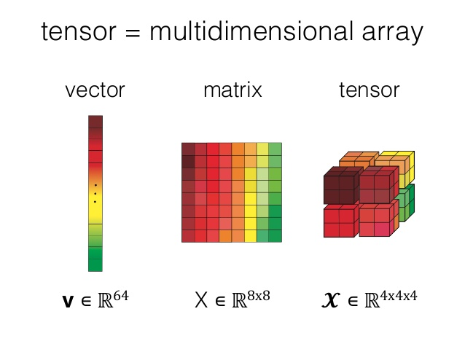
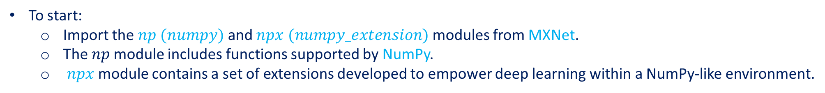
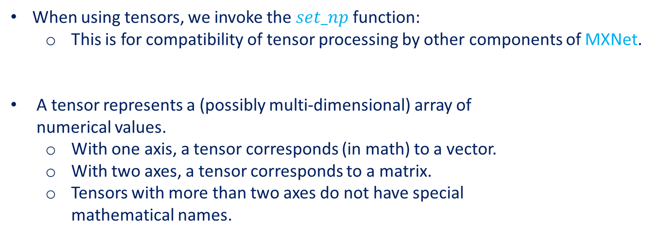
Getting Started
To start:
Import the $np (numpy)$ and $npx (numpy_extension)$ modules from MXNet.
The $np$ module includes functions supported by NumPy.
$npx$ module contains a set of extensions developed to empower deep learning within a NumPy-like environment.
from mxnet import np, npx
npx.set_np()
When using tensors, we invoke the $set_np$ function:
This is for compatibility of tensor processing by other components of MXNet.
A tensor represents a (possibly multi-dimensional) array of numerical values.
With one axis, a tensor corresponds (in math) to a vector.
With two axes, a tensor corresponds to a matrix.
Tensors with more than two axes do not have special mathematical names.
Source: https://www.i2tutorials.com/what-do-you-mean-by -tensor-and-explain-about-tensor-datatype-and-ranks/
Notes:
The slides will use MXNET module only, for other modules, refer to the original content of the book or website.

Slide 11
Getting Started
We can use $arange$ to create a row vector $x$ containing the first 12 integers starting with 0.
They are created as floats by default.
x = np.arange(12)
x
We can access a tensor’s shape (the length along each axis) by inspecting its $shape$ property.
x.shape
To know the total number of elements in a tensor, i.e., the product of all of the shape elements, we can inspect its size.
x.size
Notes:
The slides will use MXNET module only, for other modules, refer to the original content of the website.

Slide 12
Getting Started
To change the shape of a tensor without altering either the number of elements or their values, invoke the $reshape$ function.
X = x.reshape(3, 4)
X
Reshaping by manually specifying every dimension is unnecessary.
If our target is a matrix with shape (height, width), then after we know the width, the height is given implicitly.
Tensors can automatically work out one dimension given the rest. We invoke this capability by placing -1 for the dimension that we would like tensors to automatically infer.
x.reshape(-1, 4)
#or
x.reshape(3, -1)
Notes:
The slides will use MXNET module only, for other modules, refer to the original content of the website.

Slide 13
Getting Started
We can create a tensor representing a tensor with all elements set to 0 and a shape of (2, 3, 4) as follows:
np.zeros((2, 3, 4))
Similarly, we can create tensors with each element set to 1 as follows:
np.ones((2, 3, 4))
Notes:
The slides will use MXNET module only, for other modules, refer to the original content of the website.

Slide 14
Getting Started
Often, we want to randomly sample the values for each element in a tensor from some probability distribution.
For example, when we construct arrays to serve as parameters in a neural network, we initialize their values randomly.
The following snippet creates a tensor with shape (3, 4). Each of its elements is randomly sampled from a standard Gaussian (normal) distribution with a mean of 0 and a standard deviation of 1.
np.random.normal(0, 1, size=(3, 4))
We can also specify the exact values for each element in the desired tensor by supplying a Python list (or list of lists) containing the numerical values.
np.array([[2, 1, 4, 3], [1, 2, 3, 4], [4, 3, 2, 1]])
Notes:
The slides will use MXNET module only, for other modules, refer to the original content of the website.

Slide 15
Contents
CH2
Data Manipulation
Data Preprocessing
Linear Algebra
Linear Algebra cont.
Calculus
Automatic Differentiation
Probability
Documentation
Getting Started
Reading the Dataset
Scalars
Reduction
Derivatives and Differentiation
A Simple Example
Basic Probability Theory
Finding All the Functions and Classes in a Module
Operations
Handling Missing Data
Vectors
Dot Products
Partial Derivatives
Backward for Non-Scalar Variables
Dealing with Multiple Random Variables
Finding the Usage of Specific Functions and Classes
Broadcasting Mechanism
Conversion to the Tensor Format
Matrices
Matrix-Vector Products
Gradients
Detaching Computation
Expectation and Variance
Indexing and Slicing
Tensors
Matrix-Matrix Multiplication
Chain Rule
Computing the Gradient of Python Control Flow
Saving Memory
Basic Properties of Tensor Arithmetic
Norms
Conversion to Other Python Objects
+6 sections
More on Linear Algebra

Slide 16
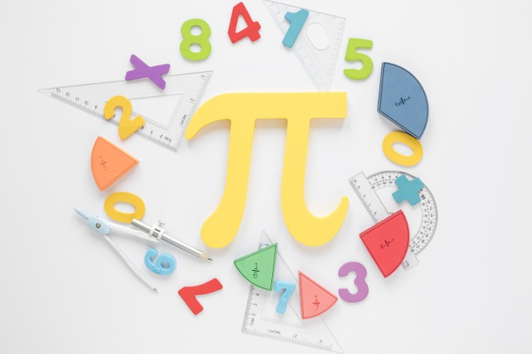
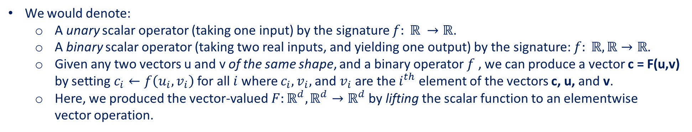
Operations
Some of the simplest and most useful operations are the elementwise operations.
These apply a standard scalar operation to each element of an array.
Source: https://www.freepik.com/free-photo/mathematics-with-numbers-pi-symbol_ 6625946.htm#page=2&query=mathematics&position=32
We would denote:
A unary scalar operator (taking one input) by the signature $f: ℝ →ℝ$.
A binary scalar operator (taking two real inputs, and yielding one output) by the signature: $f: ℝ,ℝ→ℝ$.
Given any two vectors u and v of the same shape, and a binary operator $f$ , we can produce a vector c = F(u,v) by setting $c_{i}←f\left(u_{i},v_{i}\right)$for all $i$ where $c_{i}, v_{i},$ and $v_{i}$ are the $i^{th}$ element of the vectors c, u, and v.
Here, we produced the vector-valued $F:ℝ^{d},ℝ^{d}→ℝ^{d}$by lifting the scalar function to an elementwise vector operation.
Notes:
The slides will use MXNET module only, for other modules, refer to the original content of the website.

Slide 17
Operations
In the following example, we use commas to formulate a 5-element tuple, where each element is the result of an elementwise operation.
x = np.array([1, 2, 4, 8])
y = np.array([2, 2, 2, 2])
x + y, x - y, x * y, x / y, x ** y # The ** operator is exponentiation
Many more operations can be applied elementwise, including unary operators like exponentiation.
np.exp(x)
In addition to elementwise computations, we can also perform linear algebra operations, including vector dot products and matrix multiplication.
Notes:
The slides will use MXNET module only, for other modules, refer to the original content of the website.

Slide 18
Operations
We can also concatenate multiple tensors together, stacking them end-to-end to form a larger tensor.
The example below shows what happens when we concatenate two matrices along:
Rows- axis 0, the first element of the shape.
Columns- axis 1, the second element of the shape.
X = np.arange(12).reshape(3, 4)
Y = np.array([[2, 1, 4, 3], [1, 2, 3, 4], [4, 3, 2, 1]])
np.concatenate([X, Y], axis=0), np.concatenate([X, Y], axis=1)
Sometimes, we want to construct a binary tensor via logical statements. Take X == Y as an example.
X == Y
Summing all the elements in the tensor yields a tensor with only one element.
X.sum()
Notes:
The slides will use MXNET module only, for other modules, refer to the original content of the website.

Slide 19
Contents
CH2
Data Manipulation
Data Preprocessing
Linear Algebra
Linear Algebra cont.
Calculus
Automatic Differentiation
Probability
Documentation
Getting Started
Reading the Dataset
Scalars
Reduction
Derivatives and Differentiation
A Simple Example
Basic Probability Theory
Finding All the Functions and Classes in a Module
Operations
Handling Missing Data
Vectors
Dot Products
Partial Derivatives
Backward for Non-Scalar Variables
Dealing with Multiple Random Variables
Finding the Usage of Specific Functions and Classes
Broadcasting Mechanism
Conversion to the Tensor Format
Matrices
Matrix-Vector Products
Gradients
Detaching Computation
Expectation and Variance
Indexing and Slicing
Tensors
Matrix-Matrix Multiplication
Chain Rule
Computing the Gradient of Python Control Flow
Saving Memory
Basic Properties of Tensor Arithmetic
Norms
Conversion to Other Python Objects
+6 sections
More on Linear Algebra

Slide 20
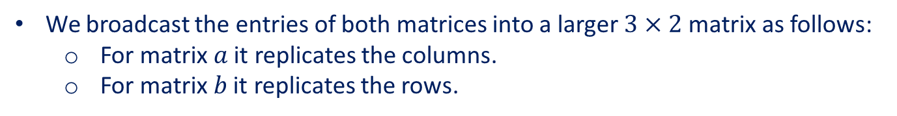
Broadcasting Mechanism
Under certain conditions, even when shapes differ, we can still perform elementwise operations by invoking the broadcasting mechanism. This mechanism works in the following way:
Expand one or both arrays by copying elements appropriately so that the two tensors have the same shape.
Carry out the elementwise operations on the resulting arrays.
In most cases, we broadcast along an axis where an array initially only has length 1, such as in the following example:
a = np.arange(3).reshape(3, 1)
b = np.arange(2).reshape(1, 2)
a, b
We broadcast the entries of both matrices into a larger $3×2$ matrix as follows:
For matrix $a$ it replicates the columns.
For matrix $b$ it replicates the rows.
a + b
Notes:
The slides will use MXNET module only, for other modules, refer to the original content of the website.

Slide 21
Contents
CH2
Data Manipulation
Data Preprocessing
Linear Algebra
Linear Algebra cont.
Calculus
Automatic Differentiation
Probability
Documentation
Getting Started
Reading the Dataset
Scalars
Reduction
Derivatives and Differentiation
A Simple Example
Basic Probability Theory
Finding All the Functions and Classes in a Module
Operations
Handling Missing Data
Vectors
Dot Products
Partial Derivatives
Backward for Non-Scalar Variables
Dealing with Multiple Random Variables
Finding the Usage of Specific Functions and Classes
Broadcasting Mechanism
Conversion to the Tensor Format
Matrices
Matrix-Vector Products
Gradients
Detaching Computation
Expectation and Variance
Indexing and Slicing
Tensors
Matrix-Matrix Multiplication
Chain Rule
Computing the Gradient of Python Control Flow
Saving Memory
Basic Properties of Tensor Arithmetic
Norms
Conversion to Other Python Objects
+6 sections
More on Linear Algebra

Slide 22
Indexing and Slicing
Elements in a tensor can be accessed by index.
The first element has index 0 and ranges are specified to include the first but before the last element.
Indices
0 1 2 3 4 5 6 7
Slice 2:5
We can access elements according to their relative position to the end of the list by using negative indices.
Thus, $[−1]$ selects the last element and $[1:3]$selects the second and the third elements as follows:
X[-1], X[1:3]
We can also write elements of a matrix by specifying indices.
X[1, 2] = 9
X
To assign multiple elements the same value, we simply index all of them and then assign them the value.
X[0:2, :] = 12
X
Notes:
The slides will use MXNET module only, for other modules, refer to the original content of the website.

Slide 23
Contents
CH2
Data Manipulation
Data Preprocessing
Linear Algebra
Linear Algebra cont.
Calculus
Automatic Differentiation
Probability
Documentation
Getting Started
Reading the Dataset
Scalars
Reduction
Derivatives and Differentiation
A Simple Example
Basic Probability Theory
Finding All the Functions and Classes in a Module
Operations
Handling Missing Data
Vectors
Dot Products
Partial Derivatives
Backward for Non-Scalar Variables
Dealing with Multiple Random Variables
Finding the Usage of Specific Functions and Classes
Broadcasting Mechanism
Conversion to the Tensor Format
Matrices
Matrix-Vector Products
Gradients
Detaching Computation
Expectation and Variance
Indexing and Slicing
Tensors
Matrix-Matrix Multiplication
Chain Rule
Computing the Gradient of Python Control Flow
Saving Memory
Basic Properties of Tensor Arithmetic
Norms
Conversion to Other Python Objects
+6 sections
More on Linear Algebra

Slide 24
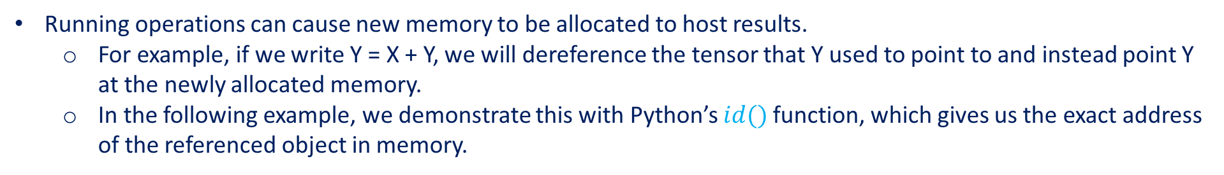


Saving Memory
Running operations can cause new memory to be allocated to host results.
For example, if we write Y = X + Y, we will dereference the tensor that Y used to point to and instead point Y at the newly allocated memory.
In the following example, we demonstrate this with Python’s $id()$ function, which gives us the exact address of the referenced object in memory.
before = id(Y)
Y = Y + X
id(Y) == before
After running $Y = Y + X$, we will find that $id(Y)$ points to a different location.
That is because Python first evaluates Y + X, allocating new memory for the result and then makes Y point to this new location in memory.
Y
Value
$$Y=Y+X$$
Y
Value
Result of $Y=Y+X$
Notes:
The slides will use MXNET module only, for other modules, refer to the original content of the website.

Slide 25
Saving Memory
Allocating new memory for new results for the same variable might be undesirable for two reasons:
We do not want to run around allocating memory unnecessarily all the time.
We might point at the same parameters from multiple variables.
In machine learning, we might have hundreds of megabytes of parameters and update all of them multiple times per second.
If we do not update in place, other references will still point to the old memory location, making it possible for parts of our code to inadvertently reference stale parameters.
Notes:
The slides will use MXNET module only, for other modules, refer to the original content of the website.

Slide 26
Saving Memory
Performing in-place operations is easy. We can assign the result of an operation to a previously allocated array with slice notation, e.g., $Y[:] = <expression>$.
For example, create a new matrix $Z$ with the same shape as $Y$, using $zeros_like$ to allocate a block of $0$ entries.
Z = np.zeros_like(Y)
print('id(Z):', id(Z))
Z[:] = X + Y
print('id(Z):', id(Z))
If the value of X is not reused in subsequent computations, we can also use X[:] = X + Y or X += Y to reduce the memory overhead of the operation.
before = id(X)
X += Y
id(X) == before
Notes:
The slides will use MXNET module only, for other modules, refer to the original content of the website.

Slide 27
Contents
CH2
Data Manipulation
Data Preprocessing
Linear Algebra
Linear Algebra cont.
Calculus
Automatic Differentiation
Probability
Documentation
Getting Started
Reading the Dataset
Scalars
Reduction
Derivatives and Differentiation
A Simple Example
Basic Probability Theory
Finding All the Functions and Classes in a Module
Operations
Handling Missing Data
Vectors
Dot Products
Partial Derivatives
Backward for Non-Scalar Variables
Dealing with Multiple Random Variables
Finding the Usage of Specific Functions and Classes
Broadcasting Mechanism
Conversion to the Tensor Format
Matrices
Matrix-Vector Products
Gradients
Detaching Computation
Expectation and Variance
Indexing and Slicing
Tensors
Matrix-Matrix Multiplication
Chain Rule
Computing the Gradient of Python Control Flow
Saving Memory
Basic Properties of Tensor Arithmetic
Norms
Conversion to Other Python Objects
+6 sections
More on Linear Algebra

Slide 28
Conversion to Other Python Objects
Converting to a NumPy tensor, or vice versa, is easy. The converted result does not share memory.
A = X.asnumpy()
B = np.array(A)
type(A), type(B)
To convert a size-1 tensor to a Python scalar, we can invoke the $item$ function or Python’s built-in functions.
a = np.array([3.5])
a, a.item(), float(a), int(a)
Notes:
The slides will use MXNET module only, for other modules, refer to the original content of the website.

Slide 29
Summary
The main interface to store and manipulate data for deep learning is the tensor ( n -dimensional array). It provides a variety of functionalities including basic mathematics operations, broadcasting, indexing, slicing, memory saving, and conversion to other Python objects.
Notes:
The slides will use MXNET module only, for other modules, refer to the original content of the website.

Slide 30
Contents
CH2
Data Manipulation
Data Preprocessing
Linear Algebra
Linear Algebra cont.
Calculus
Automatic Differentiation
Probability
Documentation
Getting Started
Reading the Dataset
Scalars
Reduction
Derivatives and Differentiation
A Simple Example
Basic Probability Theory
Finding All the Functions and Classes in a Module
Operations
Handling Missing Data
Vectors
Dot Products
Partial Derivatives
Backward for Non-Scalar Variables
Dealing with Multiple Random Variables
Finding the Usage of Specific Functions and Classes
Broadcasting Mechanism
Conversion to the Tensor Format
Matrices
Matrix-Vector Products
Gradients
Detaching Computation
Expectation and Variance
Indexing and Slicing
Tensors
Matrix-Matrix Multiplication
Chain Rule
Computing the Gradient of Python Control Flow
Saving Memory
Basic Properties of Tensor Arithmetic
Norms
Conversion to Other Python Objects
+6 sections
More on Linear Algebra

Slide 31
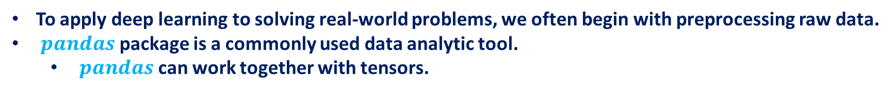
Data Preprocessing
To apply deep learning to solving real-world problems, we often begin with preprocessing raw data.
$pandas$ package is a commonly used data analytic tool.
$pandas$ can work together with tensors.
Notes:
The slides will use MXNET module only, for other modules, refer to the original content of the website.

Slide 32
Contents
CH2
Data Manipulation
Data Preprocessing
Linear Algebra
Linear Algebra cont.
Calculus
Automatic Differentiation
Probability
Documentation
Getting Started
Reading the Dataset
Scalars
Reduction
Derivatives and Differentiation
A Simple Example
Basic Probability Theory
Finding All the Functions and Classes in a Module
Operations
Handling Missing Data
Vectors
Dot Products
Partial Derivatives
Backward for Non-Scalar Variables
Dealing with Multiple Random Variables
Finding the Usage of Specific Functions and Classes
Broadcasting Mechanism
Conversion to the Tensor Format
Matrices
Matrix-Vector Products
Gradients
Detaching Computation
Expectation and Variance
Indexing and Slicing
Tensors
Matrix-Matrix Multiplication
Chain Rule
Computing the Gradient of Python Control Flow
Saving Memory
Basic Properties of Tensor Arithmetic
Norms
Conversion to Other Python Objects
+6 sections
More on Linear Algebra

Slide 33
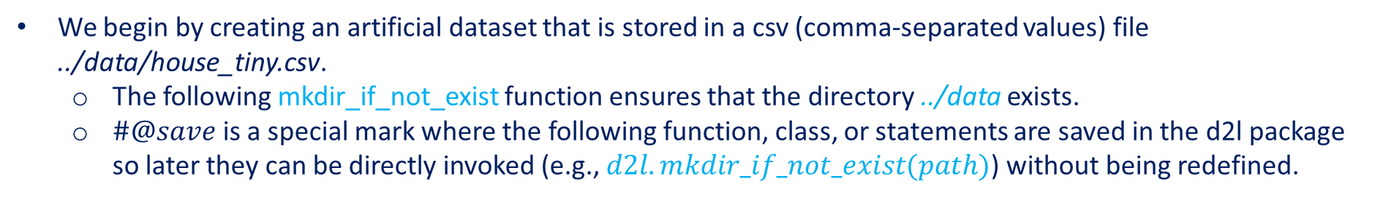
Reading the Dataset
We begin by creating an artificial dataset that is stored in a csv (comma-separated values) file ../data/house_tiny.csv.
The following mkdir_if_not_exist function ensures that the directory ../data exists.
$\#@save$is a special mark where the following function, class, or statements are saved in the d2l package so later they can be directly invoked (e.g., $d2l.mkdir_if_not_exist(path)$) without being redefined.
import os
def mkdir_if_not_exist(path): #@save
"""Make a directory if it does not exist."""
if not isinstance(path,str):
path = os.path.join(*path)
if not os.path.exists(path):
os.makedirs(path)
Notes:
The slides will use MXNET module only, for other modules, refer to the original content of the website.

Slide 34
Reading the Dataset
Below we write the dataset row by row into a csv file.
data_file = "../data/house_tiny.csv"
mkdir_if_not_exist("../data")
with open(data_file,'w') as f:
f.write('NumRooms,Alley,Price\n') # Column names
f.write('NA,Pave,127500\n') # Each row represents a data example
f.write('2,NA,106000\n')
f.write('4,NA,178100\n')
f.write('NA,NA,140000\n')
This dataset has four rows and three columns, where each row describes the number of rooms (“NumRooms”), the alley type (“Alley”), and the price (“Price”) of a house.
To load the raw dataset from the created csv file, we import the $pandas$ package and invoke the $read_csv$ function.
# If pandas is not installed, just uncomment the following line:
# !pip install pandas
import pandas as pd
data = pd.read_csv(data_file)
print(data)
Notes:
The slides will use MXNET module only, for other modules, refer to the original content of the website.

Slide 35
Contents
CH2
Data Manipulation
Data Preprocessing
Linear Algebra
Linear Algebra cont.
Calculus
Automatic Differentiation
Probability
Documentation
Getting Started
Reading the Dataset
Scalars
Reduction
Derivatives and Differentiation
A Simple Example
Basic Probability Theory
Finding All the Functions and Classes in a Module
Operations
Handling Missing Data
Vectors
Dot Products
Partial Derivatives
Backward for Non-Scalar Variables
Dealing with Multiple Random Variables
Finding the Usage of Specific Functions and Classes
Broadcasting Mechanism
Conversion to the Tensor Format
Matrices
Matrix-Vector Products
Gradients
Detaching Computation
Expectation and Variance
Indexing and Slicing
Tensors
Matrix-Matrix Multiplication
Chain Rule
Computing the Gradient of Python Control Flow
Saving Memory
Basic Properties of Tensor Arithmetic
Norms
Conversion to Other Python Objects
+6 sections
More on Linear Algebra

Slide 36
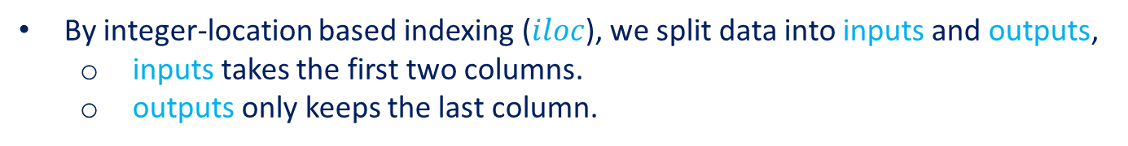
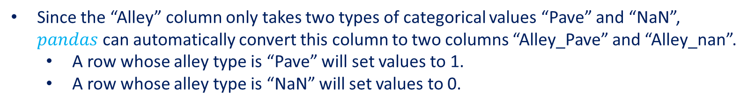
Handling Missing Data
“NaN” entries are missing values. To handle missing data, typical methods include imputation and deletion:
imputation replaces missing values with substituted ones. (that will be considered)
deletion ignores missing values.
By integer-location based indexing ($iloc$), we split data into inputs and outputs,
inputs takes the first two columns.
outputs only keeps the last column.
For numerical values in inputs that are missing, replace the “NaN” entries with the mean value of the same column.
For categorical or discrete values in inputs, we consider “NaN” as a category.
inputs, outputs = data.iloc[:,0:2], data.iloc[:,2]
inputs = inputs.fillna(inputs.mean())
print(inputs)
Since the “Alley” column only takes two types of categorical values “Pave” and “NaN”, $pandas$ can automatically convert this column to two columns “Alley_Pave” and “Alley_nan”.
A row whose alley type is “Pave” will set values to 1.
A row whose alley type is “NaN” will set values to 0.
inputs = pd.get_dummies(inputs,dummy_na=True)
print(inputs)
Notes:
The slides will use MXNET module only, for other modules, refer to the original content of the website.

Slide 37
Contents
CH2
Data Manipulation
Data Preprocessing
Linear Algebra
Linear Algebra cont.
Calculus
Automatic Differentiation
Probability
Documentation
Getting Started
Reading the Dataset
Scalars
Reduction
Derivatives and Differentiation
A Simple Example
Basic Probability Theory
Finding All the Functions and Classes in a Module
Operations
Handling Missing Data
Vectors
Dot Products
Partial Derivatives
Backward for Non-Scalar Variables
Dealing with Multiple Random Variables
Finding the Usage of Specific Functions and Classes
Broadcasting Mechanism
Conversion to the Tensor Format
Matrices
Matrix-Vector Products
Gradients
Detaching Computation
Expectation and Variance
Indexing and Slicing
Tensors
Matrix-Matrix Multiplication
Chain Rule
Computing the Gradient of Python Control Flow
Saving Memory
Basic Properties of Tensor Arithmetic
Norms
Conversion to Other Python Objects
+6 sections
More on Linear Algebra

Slide 38
Conversion to the Tensor Format
Now that all the entries in inputs and outputs are numerical, they can be converted to the tensor format.
Once data are in this format, they can be further manipulated with those tensor functionalities.
from mxnet import np
X,y = np.array(inputs.values), np.array(outputs.values)
X,y
Notes:
The slides will use MXNET module only, for other modules, refer to the original content of the website.

Slide 39
Summary
Like many other extension packages in the vast ecosystem of Python, $pandas$ can work together with tensors.
Imputation and deletion can be used to handle missing data.
Notes:
The slides will use MXNET module only, for other modules, refer to the original content of the website.

